Slide 1
REVERSIBLE DATA HIDING IN ENCRYPTED IMAGES BY REVERSIBLE IMAGE TRANSFORMAION
PROJECT GUIDE:
Mrs. Shilpa Joseph
PRESENTED BY
Augustine Johny
Bestin Paul
Jomin V George
Robin J Augustine
Group No: 6

Slide 2
PROBLEM STATEMENT
Vital to protect privacy of data such as images and videos

Slide 3
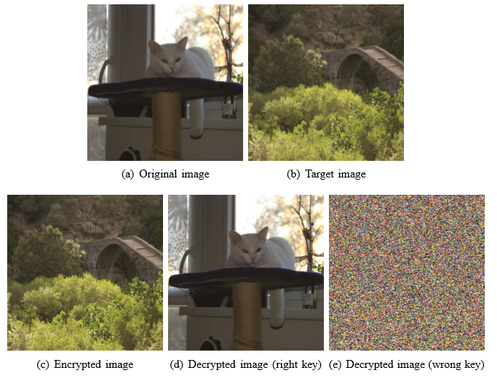
OBJECTIVE

Slide 4
OBJECTIVE
To create an RIT framework.
- transfer semantics of original image (I) to that of the target image (J).
- reversibility means (I) can be losslessly restored form J.
- (J) is the same size as (I).

Slide 5
Functional Requirements

Slide 6
Product Function
Image Acquisition
Encryption
Decryption
Image Retrieval

Slide 7
Image Acquisition
Description and Priority
The original image and target image are input into the system.
Functional Requirements
FREQ-1:System should accept original image.
FREQ-2:System should accept target image.

Slide 8
Encryption
Description and Priority
The original image is hidden within the target image.
Functional Requirements
FREQ-1:System should use encryption algorithm,
FREQ-2: System should generate key for decryption
FREQ-3:The client must assign access rights.

Slide 9
Decryption
Description and Priority
The decryption process extracts the original image from the encrypted image.
Functional Requirements
FREQ-1:The client must provide a valid key.
FREQ-2: The client must have valid access rights
FREQ-3:The system should implement anti-transformation algorithm.

Slide 10
Image Retrieval
Description and Priority
The decrypted image is sent to the requesting client.
Functional Requirements
FREQ-1:The client must be logged in as a valid user.

Slide 11
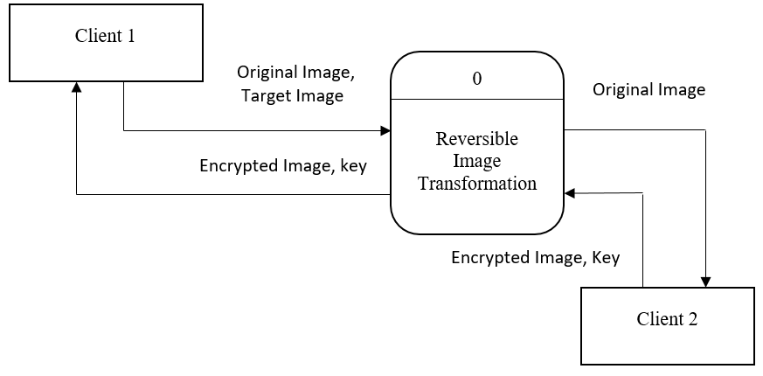
Level 0 DFD

Slide 12
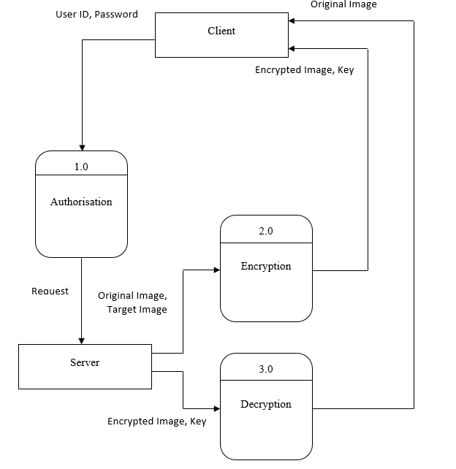
Level 1 DFD

Slide 13
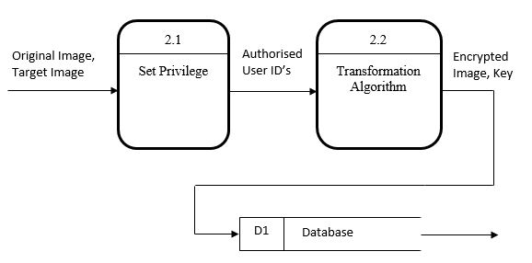
Level 2 DFD (Encryption)

Slide 14
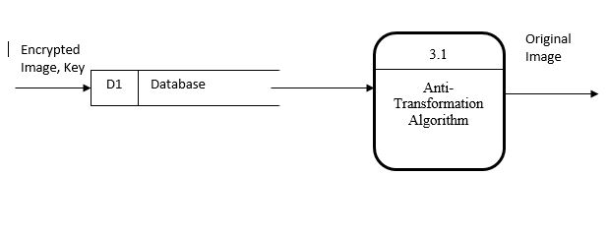
Level 2 DFD (Decryption)

Slide 15
CONCLUSION
The project proposes to encrypt the data as a plaintext itself.
Which protects from detection by hackers.
Non-privileged users cannot access data.

Slide 16
THANK YOU!

